Slide 1

The Accessible Ukulele The Joule Jugglers
Dominic Pedavoli Kaleb Keller Kameron Lund Ryan Loar

Slide 2




Meet The Joule Jugglers
Dominic – 3D Design
Kameron - Code
Ryan – Float (All)
Kaleb - Circuitry

Slide 3
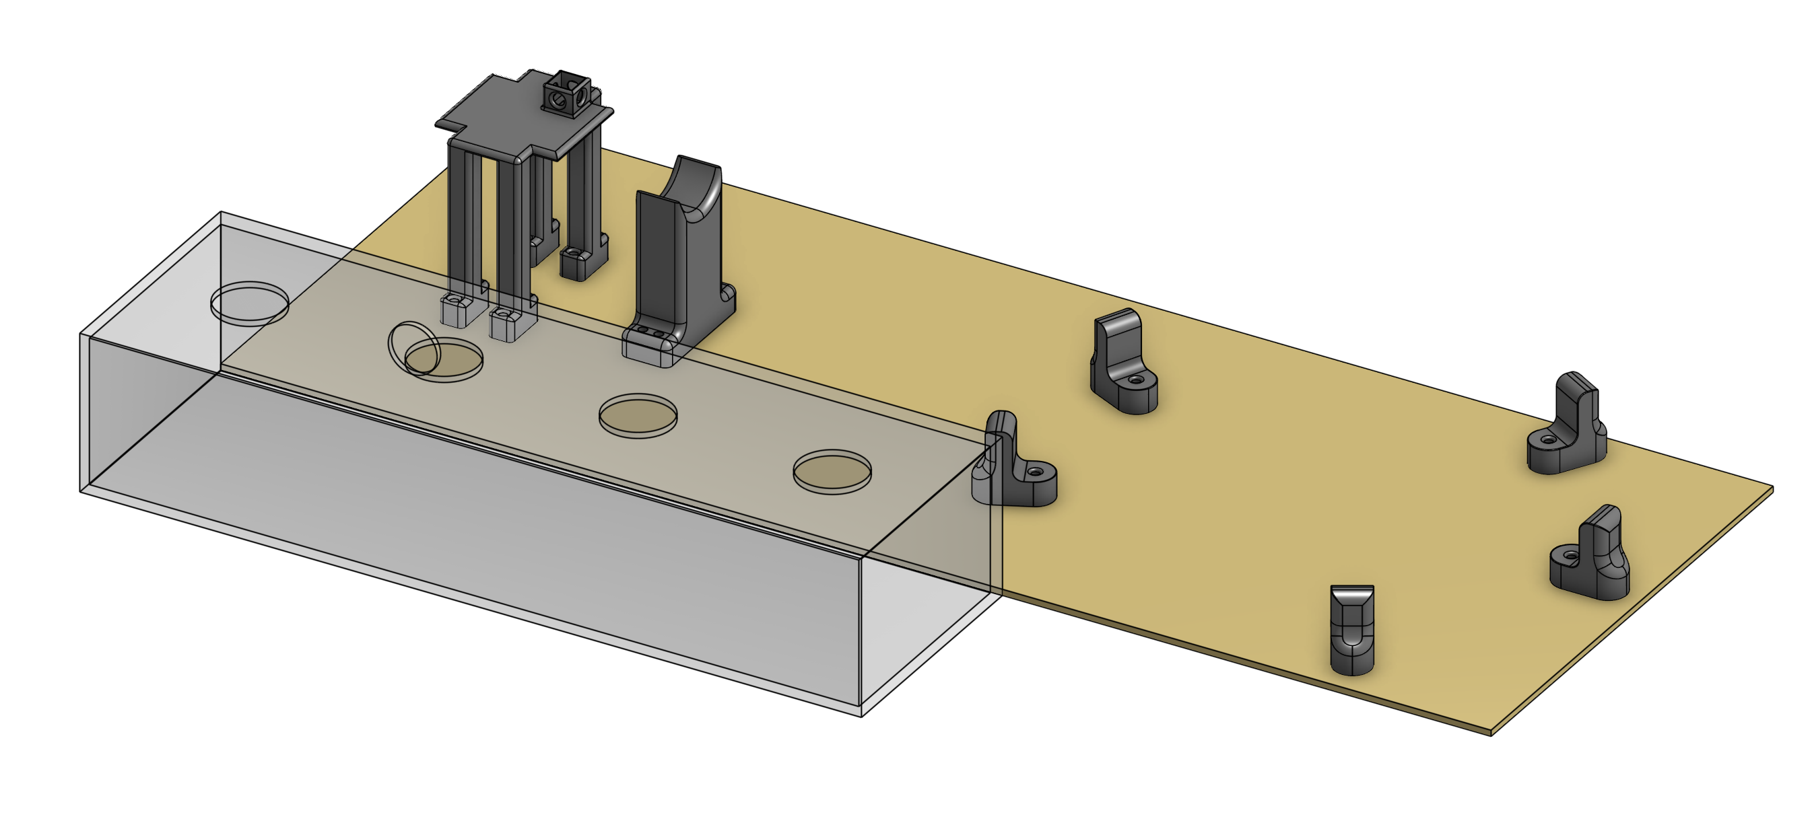
The Accessible Ukulele

Slide 4
Clients – Target Market
Motor Control Disabilities
Amputees

Slide 5
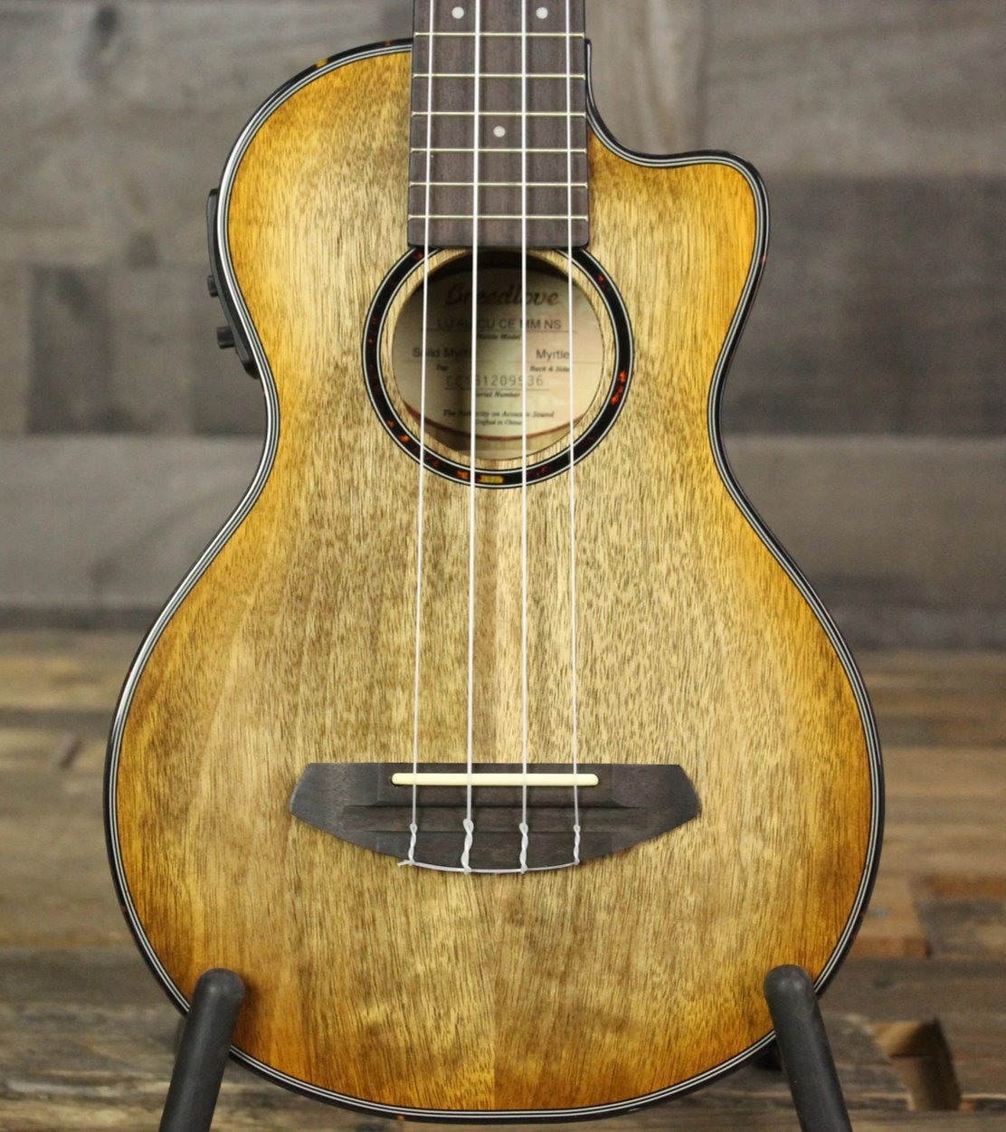
Problem Statement
The ability to play the ukulele is not accessible to those who lack fine motor control in their hands or fingers

Slide 6
Outline
Clients
Problem Statement
Design
Testing
Risk Mitigation
Definition of Success
Timeline
Bill of Materials

Slide 7
Design
Solenoid Housing
Electronics and Ukulele Housing
Software
Circuitry

Slide 8
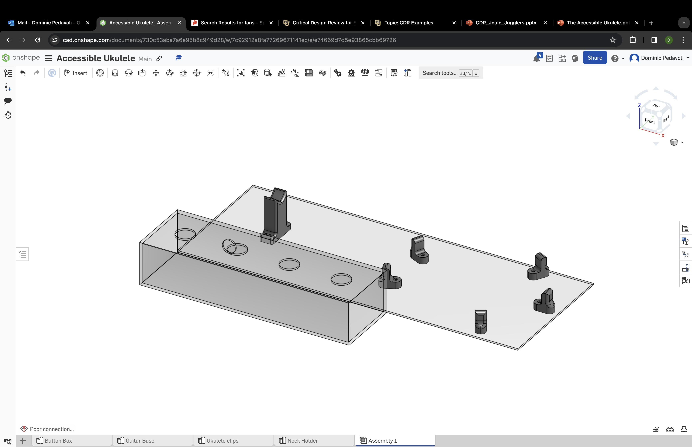
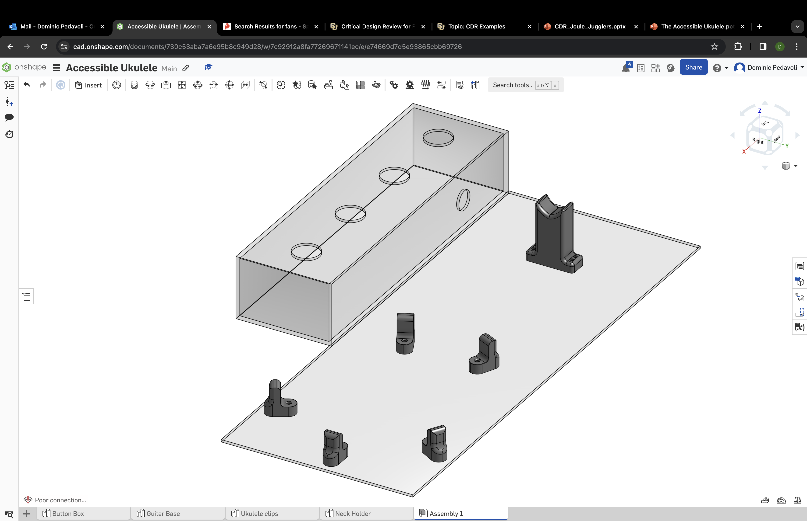
Electronics & Ukulele Housing
15"
26"
Back View
Front View
Laser cut acrylic for electronics housing
3D Printed clips and stands to keep the ukulele in place

Slide 9
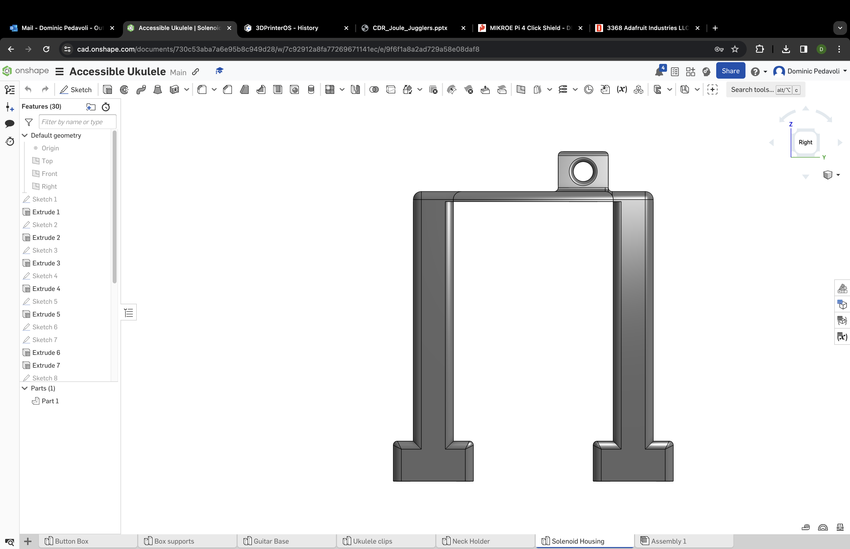
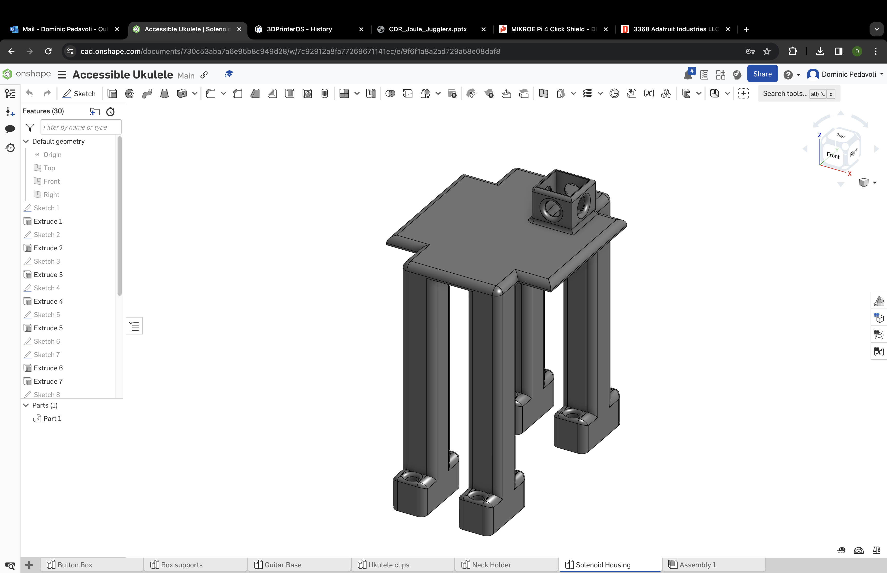
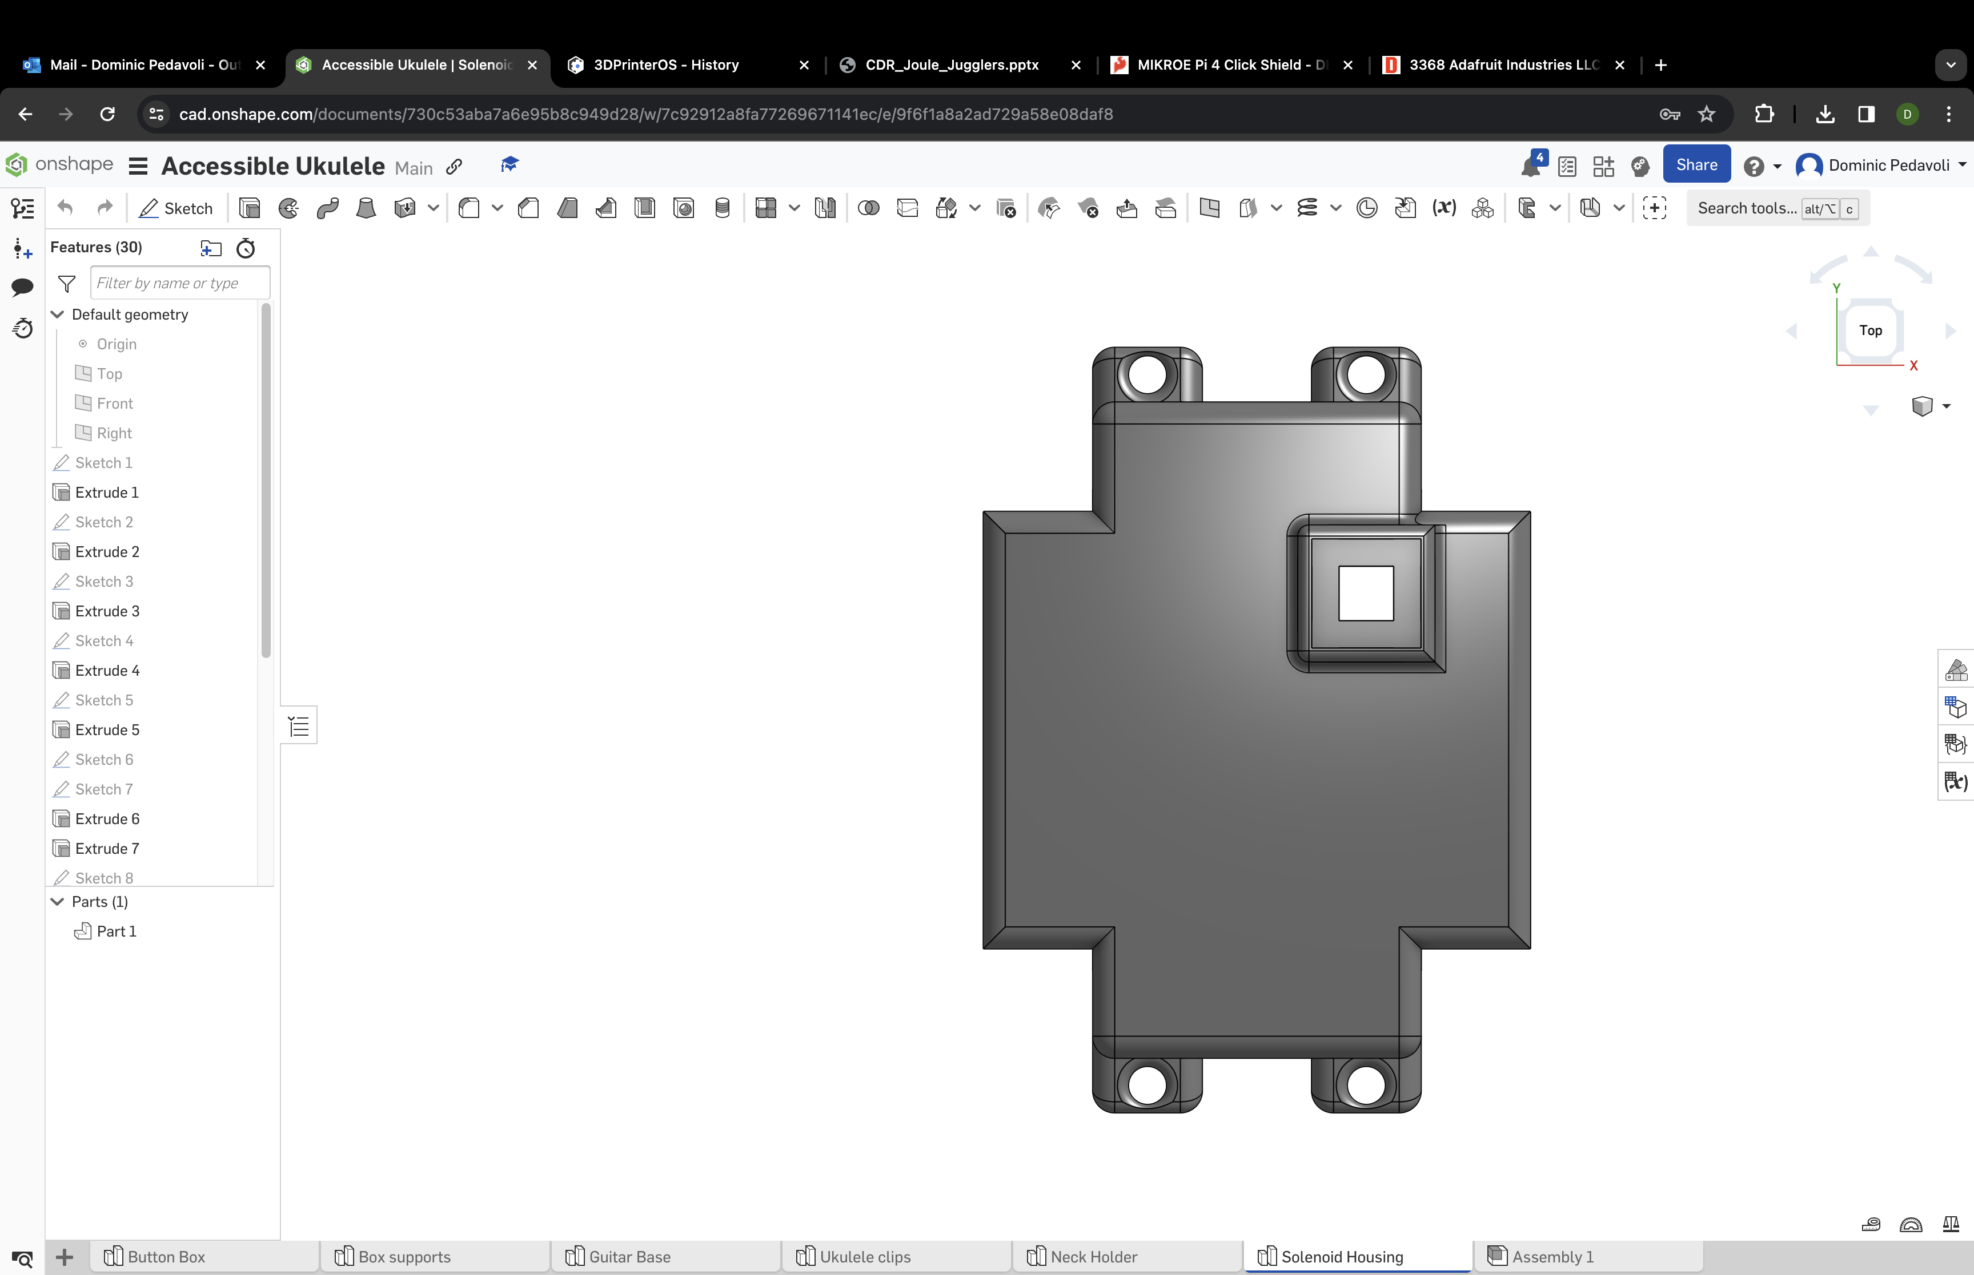
Solenoid Housing
Side View
4.125"
3.5"
Top View
3.5"
3"

Slide 10
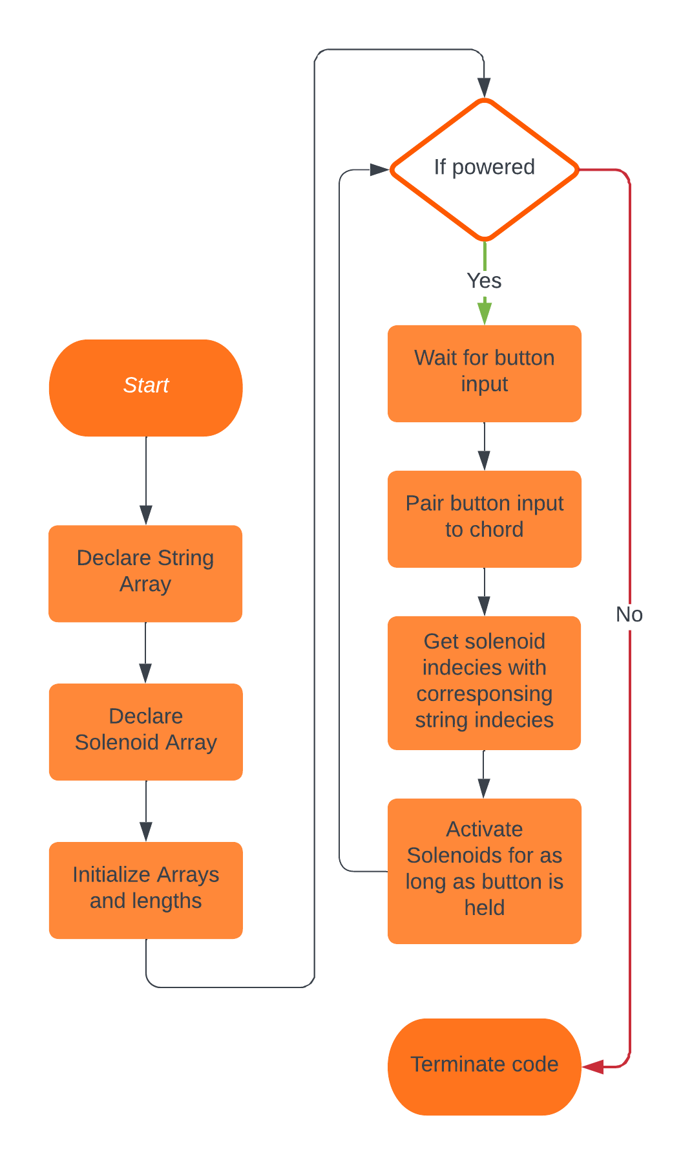
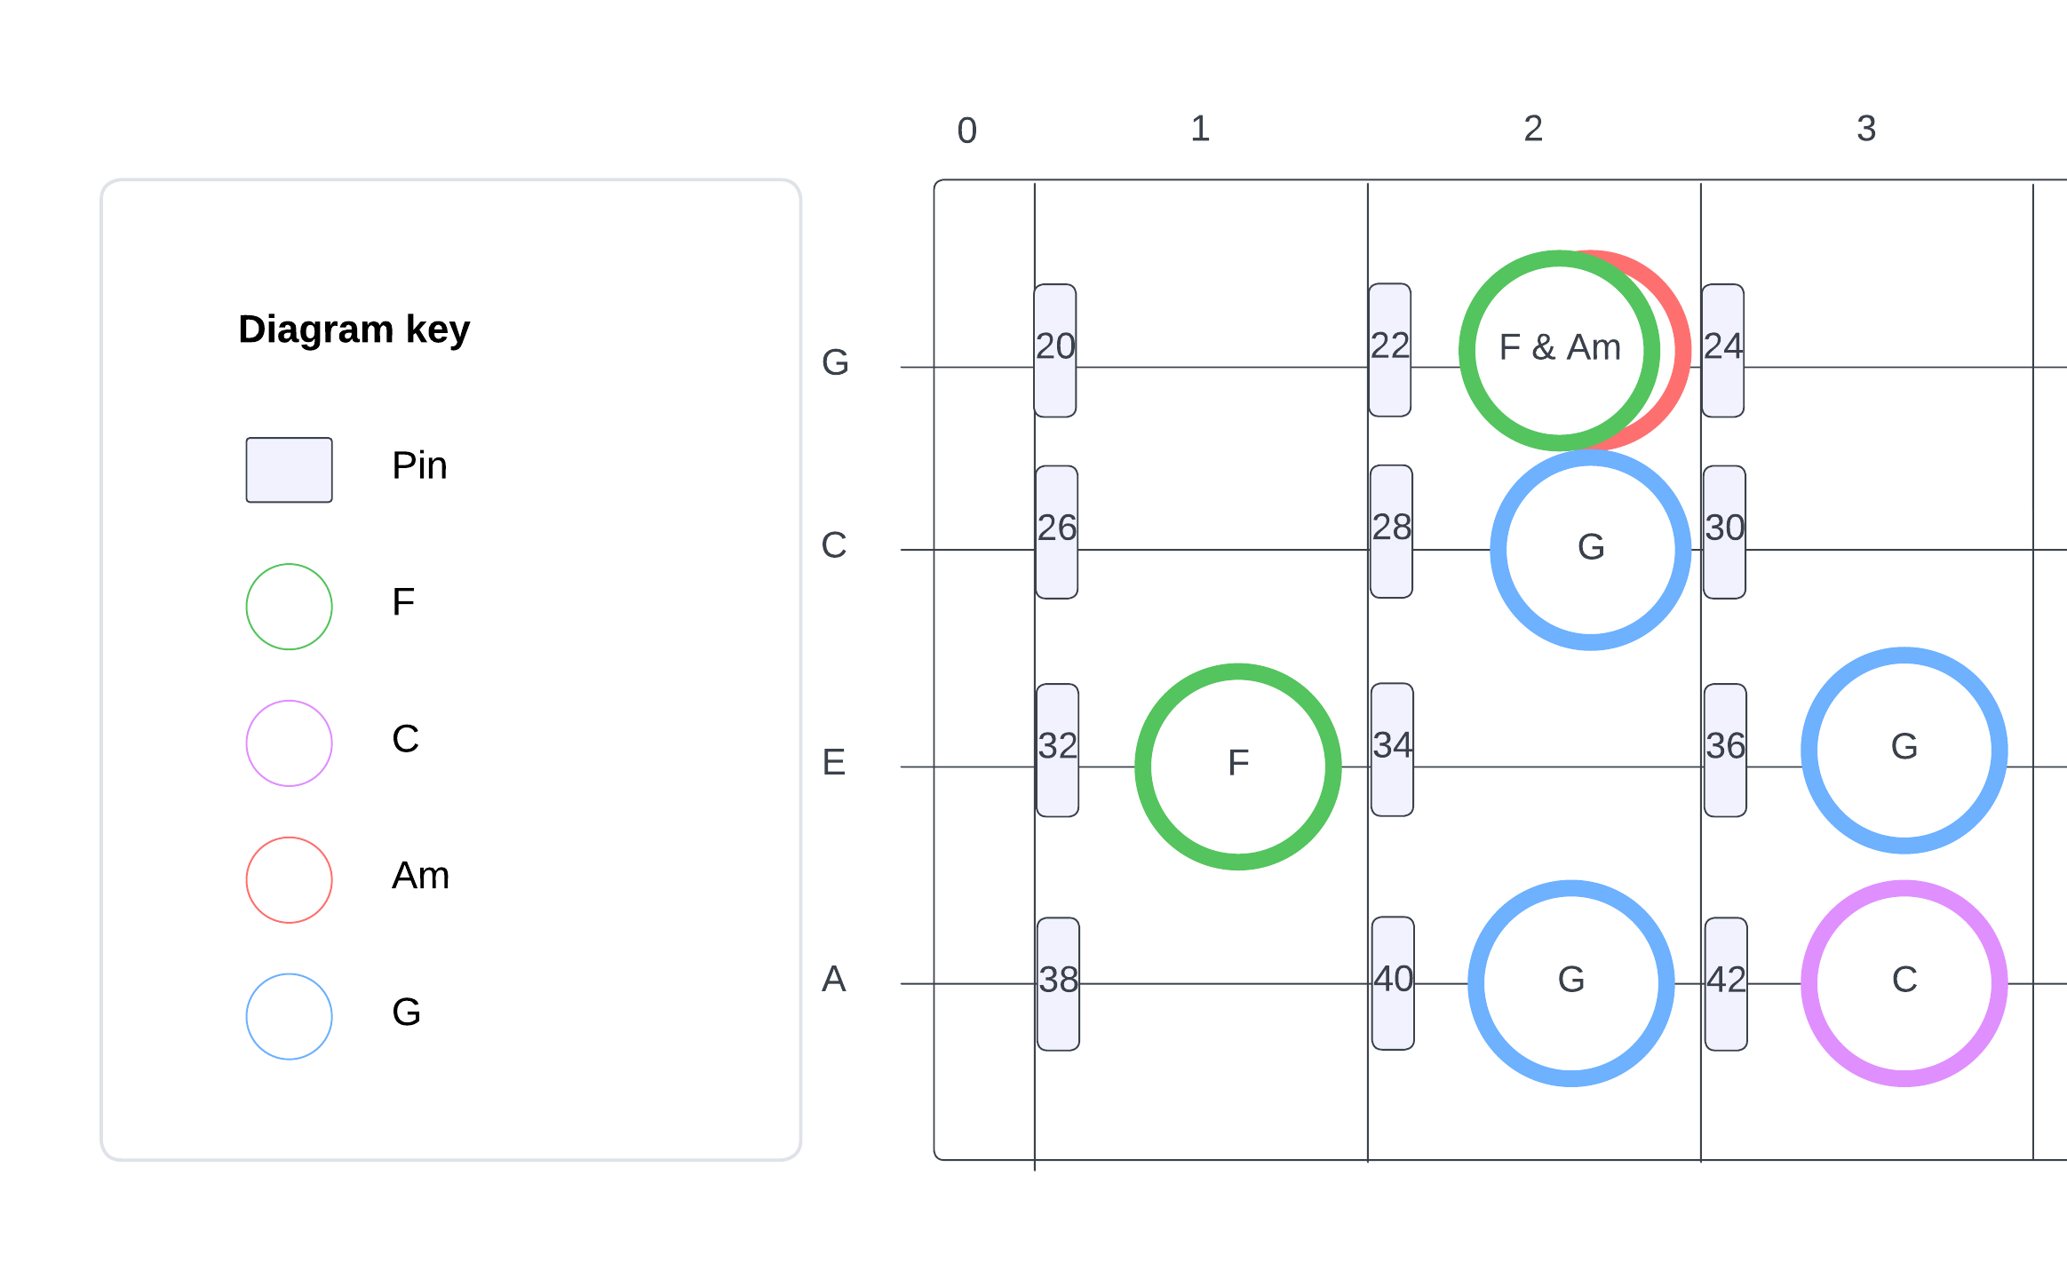
Software
Chord-string reference sheet
Code block diagram

Slide 11
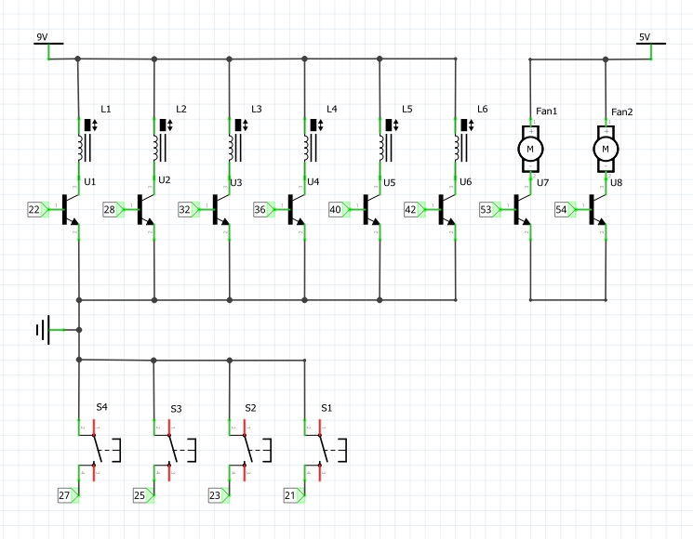
Circuit Diagram
Upper-Left | Solenoids
Upper-Right | Fans
Bottom-Left | Buttons

Slide 12
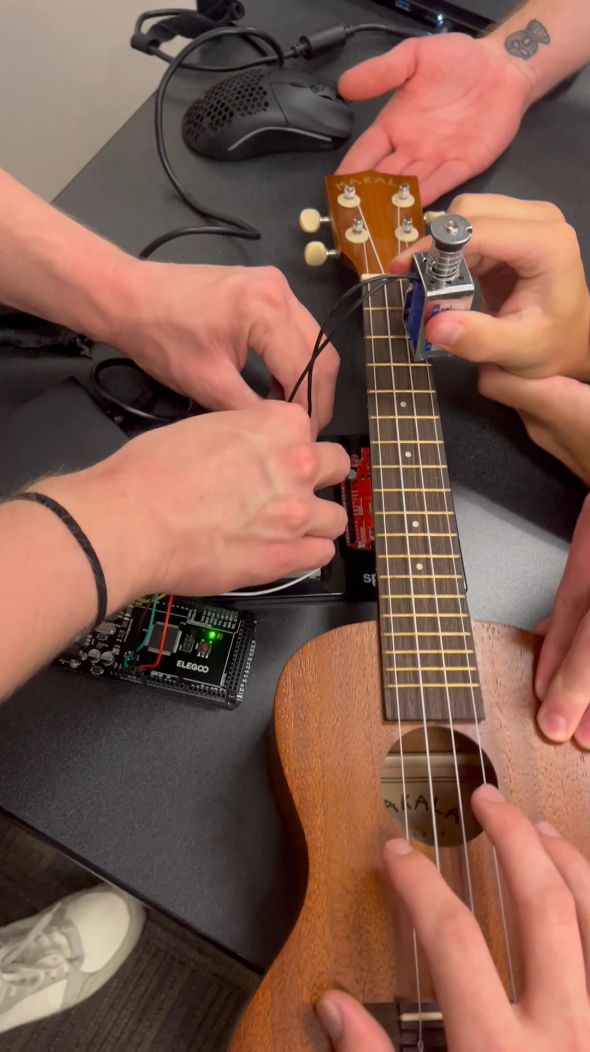
Testing
Running 9V through small solenoid
Temperature Testing
Seconds Activated | Temp (No Fan) | Temp (With Fan)
0 | 72.34 | 74.71
22.5 | 75.55 | 79.99
45 | 87.02 | 85.26
67.5 | 95.22 | 89.66
90 | 103.70 | 93.17

Slide 13
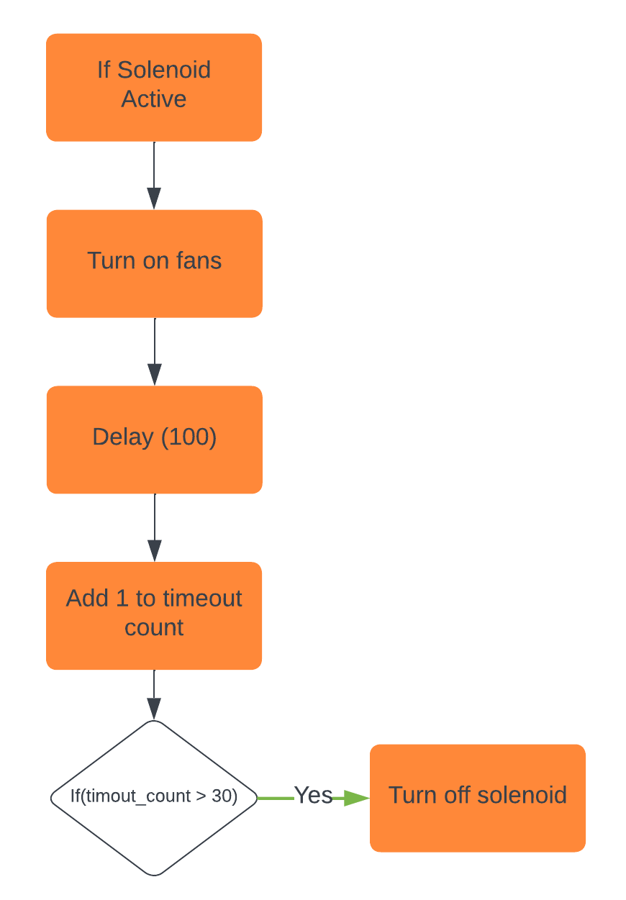
Risk Mitigation
Back up solenoid
Hard-locking solenoid mechanism in code
Fan Duty Cycle
Safe Fan Placement
Fan warning (stickers)
Heat dissipation...
Safety Logic Block Diagram

Slide 14
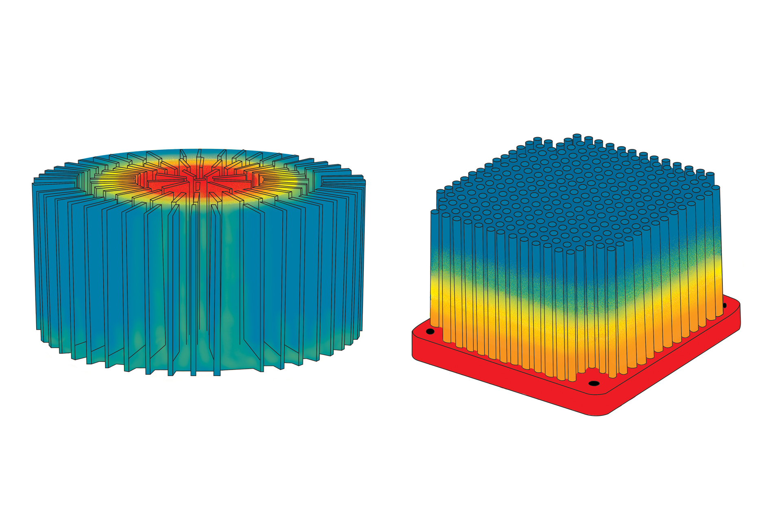
Heat Dissipation
Setting aside budget for heat dissipation
Fans
Fins
Heat sink
Thermal paste
Heat warning (stickers)
Surface Area
Temperature
Heat Sink Thermal Maps

Slide 15
Definition of Success
With this project, we strive to…
Ensure Solenoids play chords consistently
Seamless integration of the solenoid and the ukulele
Maximize accessibility while decreasing triviality
Keep solenoids below 100° F
Minimum of 3-minute run time
Implement 4 basic chords

Slide 16
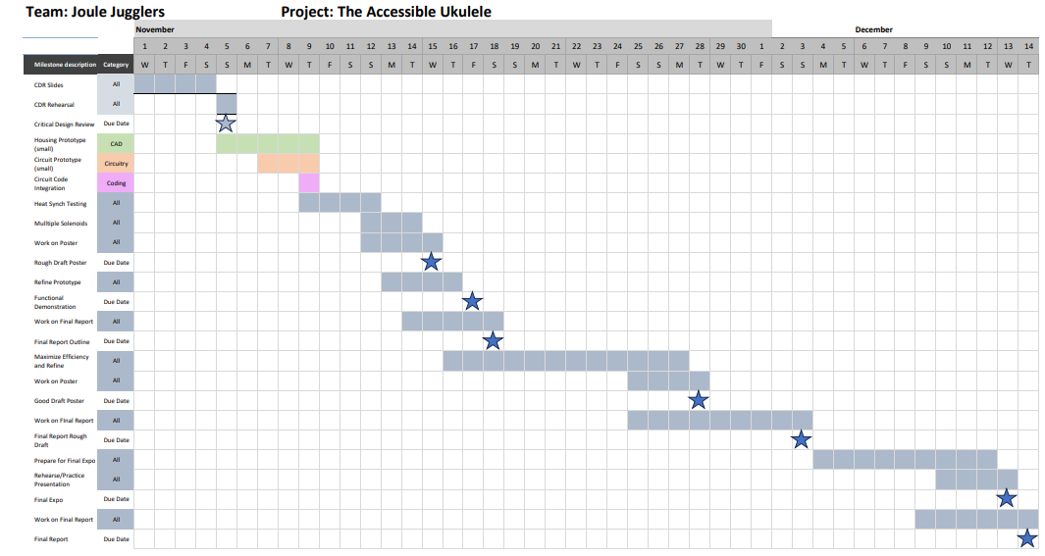
Timeline – Gantt Chart

Slide 17
Bill of Materials
Quantity & Product | Price per | Total Cost
6 5V Solenoids | $5.50 each | $33.00
6 13.2 x 12.1 mm Copper Heatsinks | $1.95 each | $11.70
6 Transistors | $0.00 each | $0.00
4 Buttons | $12.95 each | $51.80
1 Arduino Mega (Elegoo) | $21.00 each | $21.00
1 30 x 30 mm fan | $3.50 each | $3.50
1 9V DC Power Supply | $14.00 each | $14.00
Total | - | $135.00
Margin | - | $165.00

Slide 18
Conclusion
Problem – Stringed instruments require fine motor skill. Limits creativity for many.
Solution – Using solenoids to eliminate the fine motor skill requirement.
Next Steps:
Finalize Housing
Heat Management
Code Safe Limits
Final Circuit
Play a Song

Slide 19

Questions?

Slide 20
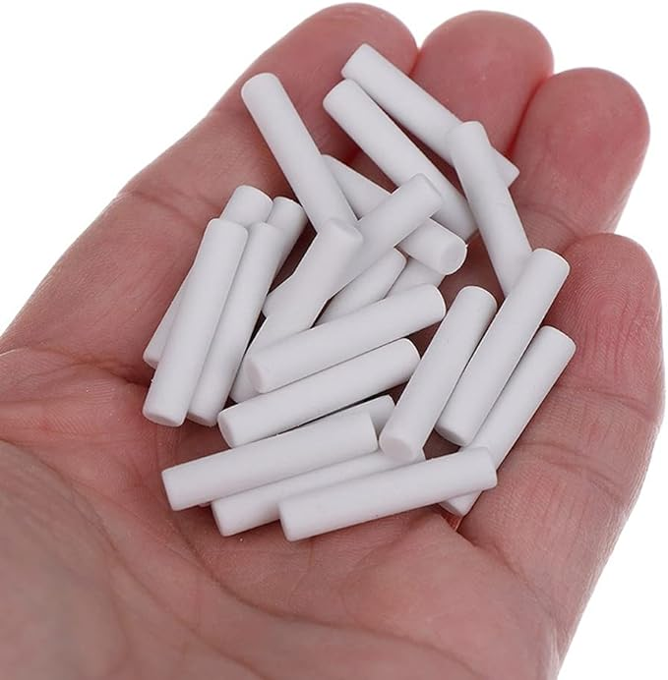
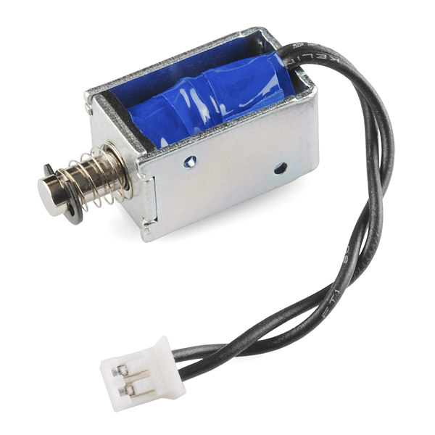
Solenoid Tip
Pencil erasers are cheap
Most like human finger'
Reduces initial vibration from solenoid push - Absorbent

Slide 21
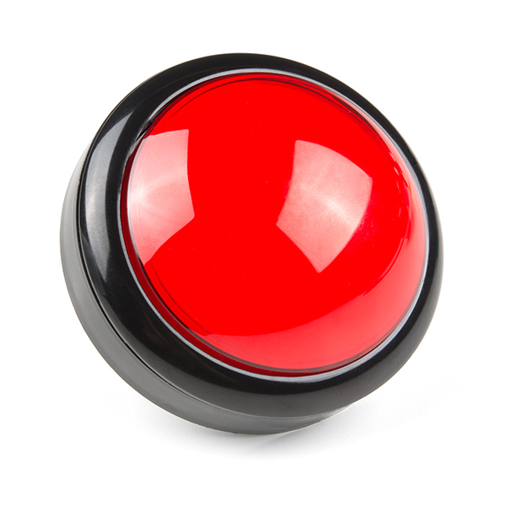
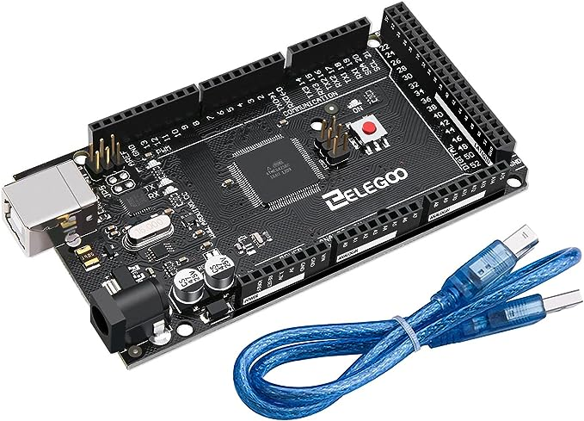
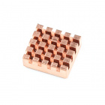
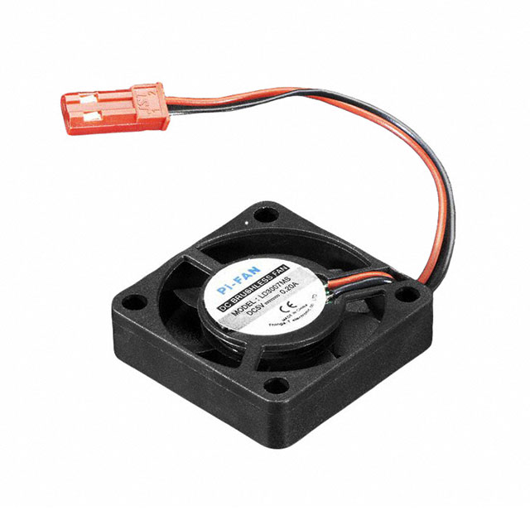
Major Components

Slide 22
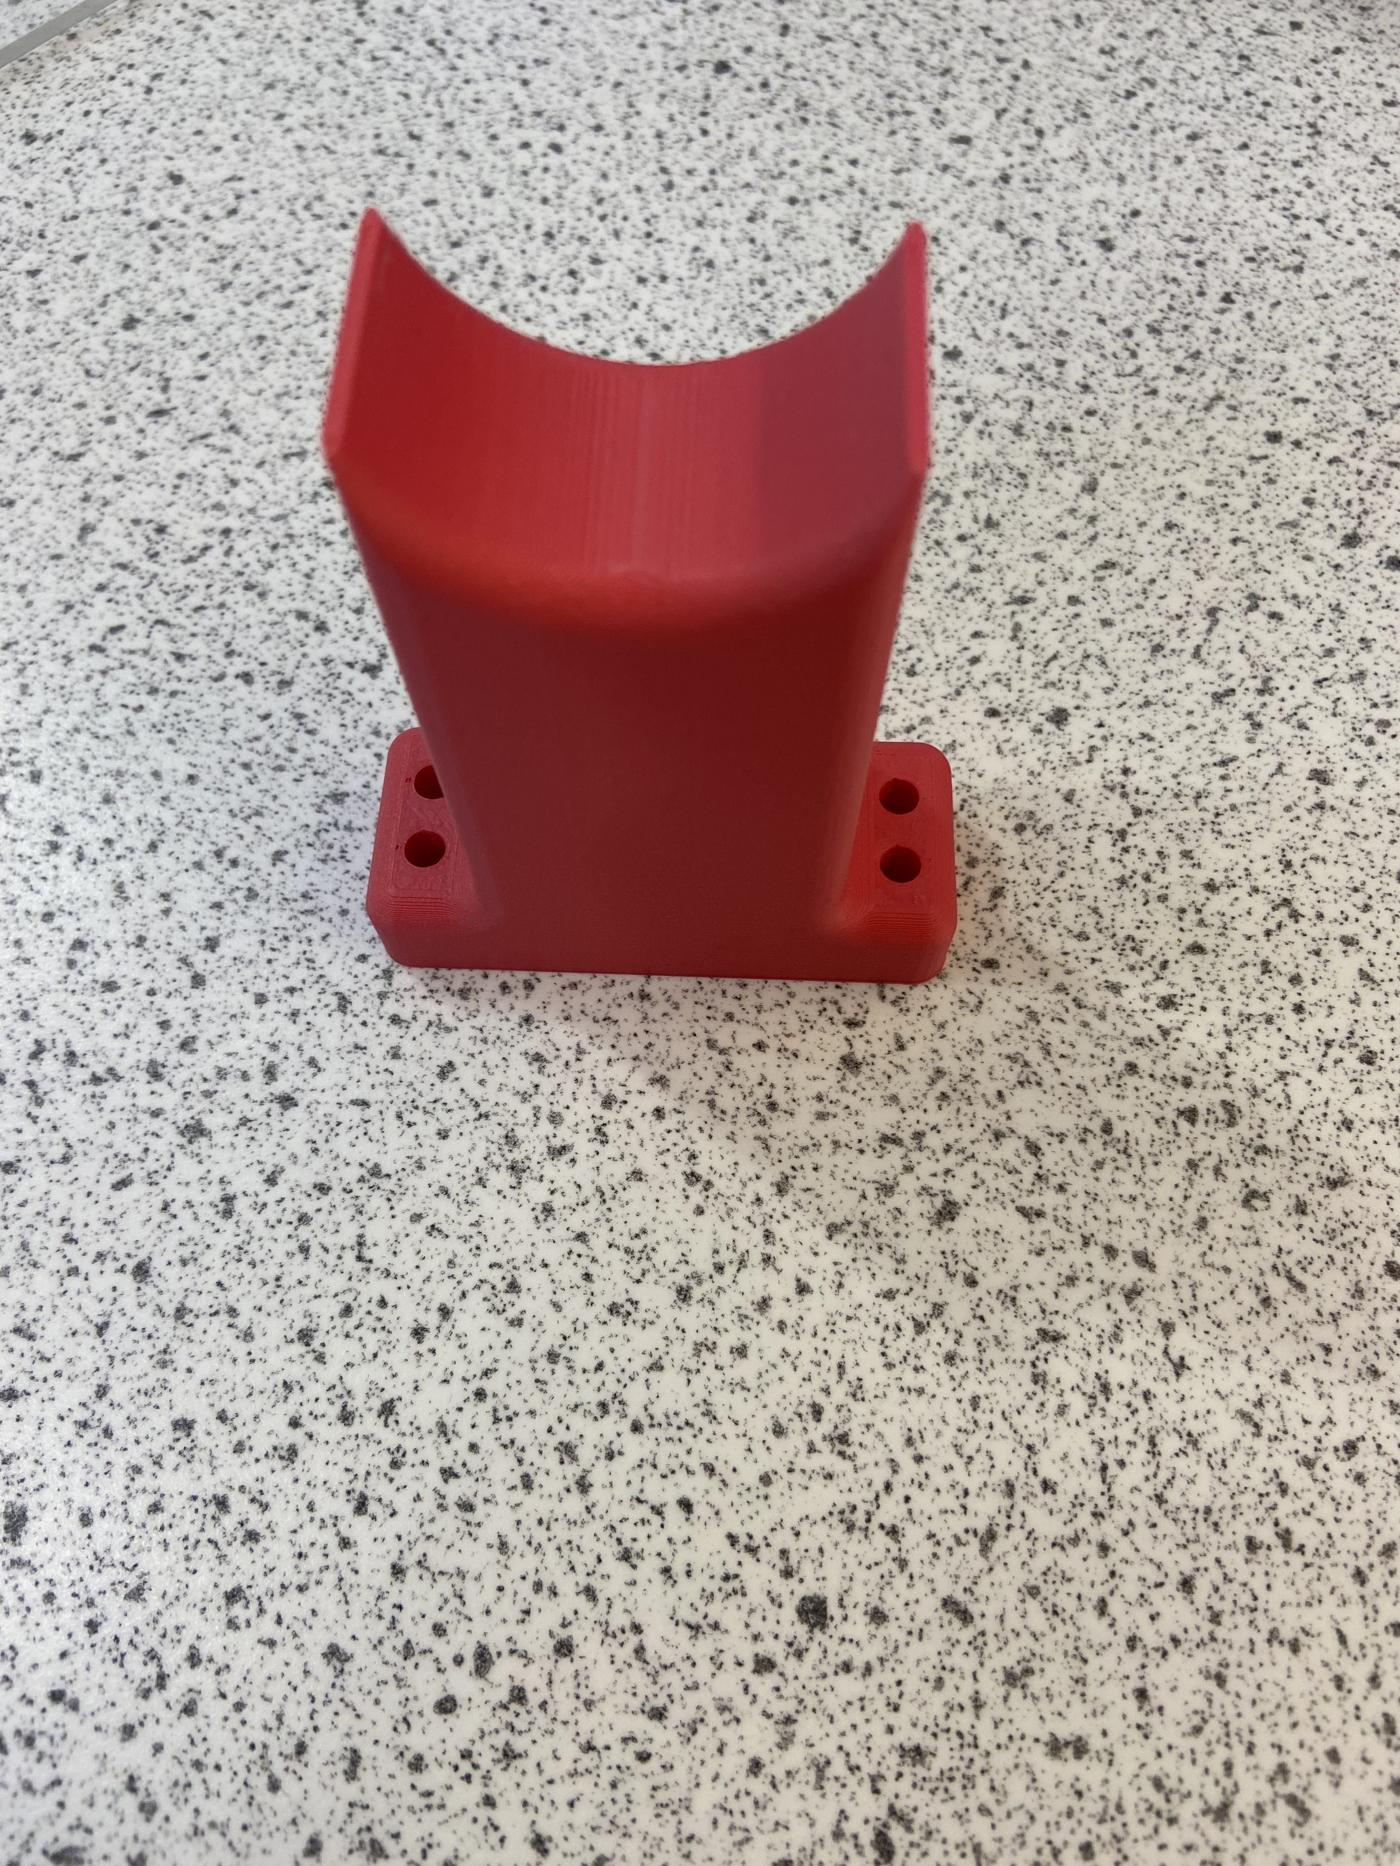
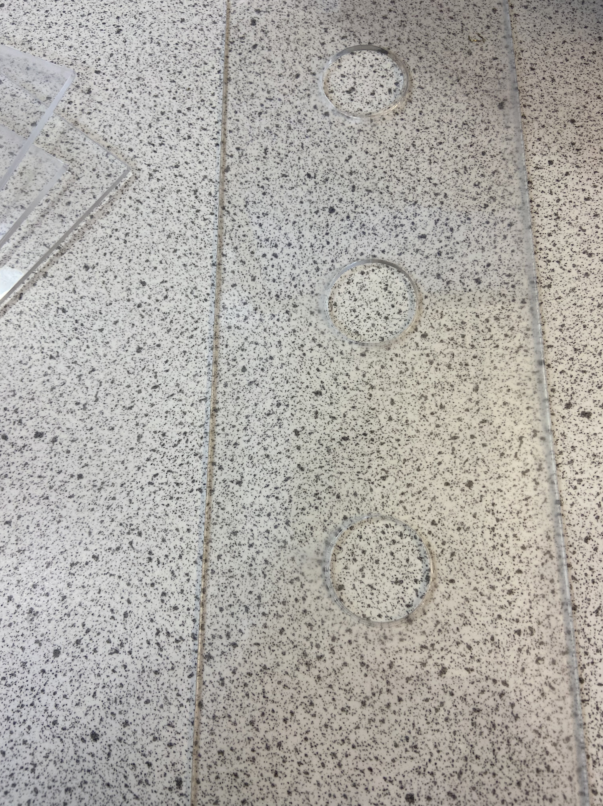
Housing Materials
Button housing – Acrylic + (PLA)
Ukulele base plate – Wood
Ukulele restraints – (PLA)

